Slide 1
Intro to Quantum Mechanics

Slide 2
What is Quantum Mechanics?
Quantum mechanics (QM) is a theory describing properties of nature on a small scale.
QM is applicable to atomic and subatomic scale.
At the other end of the scale, with objects travelling at the speed of light and in the presence of large gravitational fields, we use Einstein’s theory of relativity.
QM is a mathematical framework used to model physical phenomena, like all other domains of physics.

Slide 3
Superposition
Superposition is a key principle of QM which is leveraged for quantum computation.
In classical physics and engineering, superposition is the concept of adding two separate physical quantities to make a new physical quantity, whose ‘effect’ is the combination of the quantities.
Quantum superposition is the notion that a quantum system is in “multiple states” until it is measured.

Slide 4
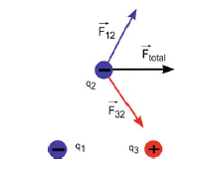
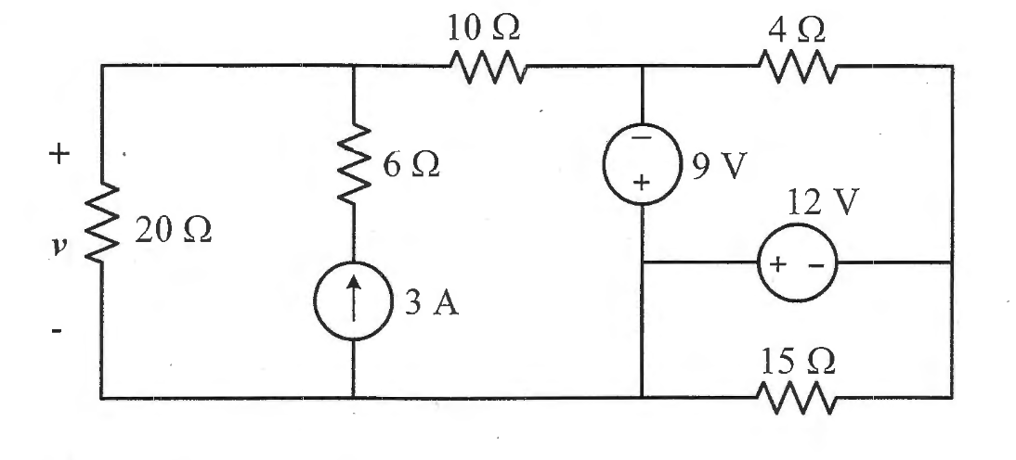
Superposition
Bottom wave is the superposition of the top two waves. Interference is constructive or destructive depending on phase.
Circuit with multiple voltage sources solved by analyzing response to sources one-by-one and adding them together
Total Electric Force on a charge
due to two other charges

Slide 5
Superposition
A quantum system is made up of small particles such as nuclei, electrons, protons, and other elementary particles.
Quantum systems are observed to exhibit many non-classical effects.

Slide 6


Superposition – Quantized State
In classical physics, objects are expected to have an arbitrary amount of kinetic energy depending on its velocity.
Example: a ball has 0 kinetic energy at rest and can vary continuously in energy depending on the speed at which it’s thrown.
In QM, a particle’s energy is quantized, meaning it can only have certain discrete values.
At the quantum scale, the energy gaps are pronounced.
As we zoom out in scale, a system’s energy becomes more dense and appears continuous.
Quantum System
Zoom out using a classical lens
Classical System

Slide 7
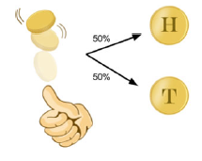
Superposition
Consider tossing a fair coin:
50/50 probability of landing either heads or tails.
What state is the coin in while it’s in the air?
Before landing, the coin is in a superposition of both possible states.
When the coin lands, we observe the coin, thus making a measurement and destroying the superposition.

Slide 8
Superposition
A system at a given time can be described as being in a particular or definite state.
The definite state is related to its quantized values
Heads or tails
Electron orbiting a nucleus can be in ground state or excited state.

Slide 9
Superposition
A quantum system is special because it can be in a superposition of the definite states; both heads and tails simultaneously, both ground and excited states simultaneously.
A ‘combination’ of all possible discrete states
Each definite state of quantum system has a given probability of being observed
Measuring the system will collapse the superposition into one of the definite classical states.

Slide 10
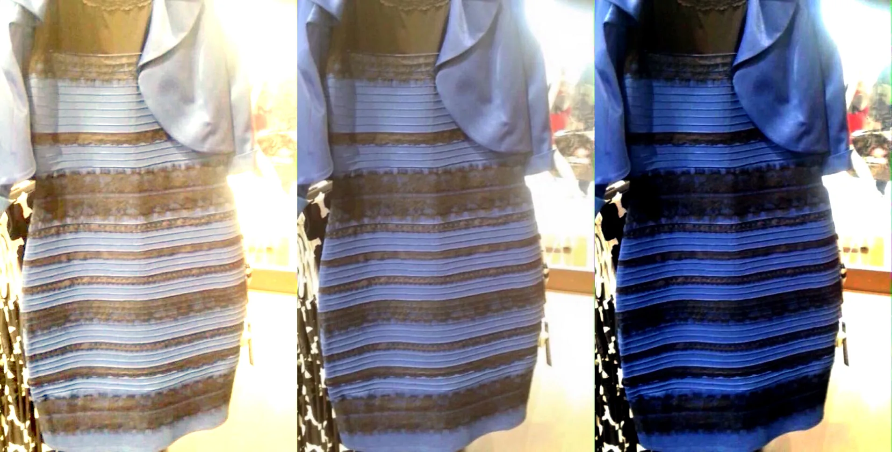
Superposition - Example
Dress is seen as white/gold by student A and blue/black by student B. Is the dress in a quantum superposition?
No
100 copies of the picture will all appear to student A as white/gold and to student B as blue/black.
In a quantum superposition, each student would see about half of the pictures as white/gold and the rest as blue/black
The two definite states must be an intrinsic property of the dress, rather than depending on the observer.

Slide 11
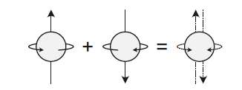
Superposition - Example
Some atomic/subatomic particles have properties that can be in a state of superposition, where the state can be multiple values at the same time.
One property of electrons which can be in superposition is spin.
An electron has two kinds of spin: spin-up and spin-down. It can also be in the superposition state of spin-up and spin-down
Spin-up
Spin-down
Superposition of Spin-up & Spin-down

Slide 12
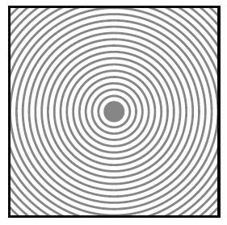
Wave-Particle Duality
Consider a square pool filled with water
Imagine dropping a marble in the center of the square pool.
You will notice a circular pattern of waves moving to the edge.
The wave will start at the center of the pool and travel to the edges.
The further the wave travels, the lower its height is.
The height of the water impacting the edges will be higher than the corner.

Slide 13

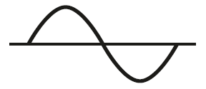
Wave-Particle Duality
If the water hits one side of the square pool with equal force across the entire width, the wave will not be circular.
Instead the wave will travel to the other side of the pool in a straight line.
The wave in the water can be represented as a sine wave.

Slide 14
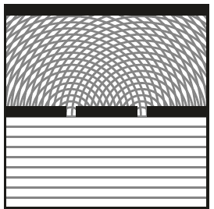

Wave-Particle Duality
Imagine a divider halfway the square pool with two slits.
The traveling wave will hit the divider for most of it.
Where there are slits, the wave will move forward.
Since there are two slits, two separate circular waves will form, and eventually meet each other.
Finally, when the waves reach the edge furthest from the initial pushed edge, a pattern is created due to constructive and destructive interference.

Slide 15
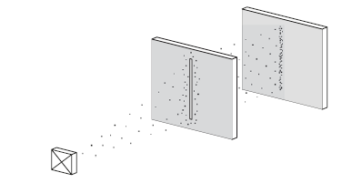
Wave-Particle Duality – Double Slit Experiment
Instead of water, repeat the experiment with electrons (particles).
Using a barrier with a single slit, we can observe some electrons hitting the surface behind the barrier, indicating electrons passing through the slit.

Slide 16
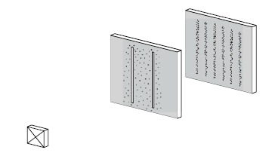
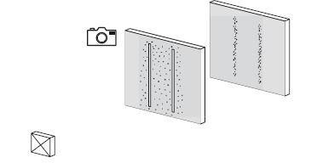
Wave-Particle Duality – Double Slit Experiment
Repeat with two slits
Instead of two vertical lines on the surface behind the two slits, an interference pattern is seen.
If a bleeping electron measurement device was placed on one of the slits, in 50% of the cases the device would bleep indicating the passing of an electron, and resulting in two vertical lines on the surface behind the two slits

Slide 17
Wave-Particle Duality
The electron after leaving the electron gun “lose their connection” with our reality and becomes a wave.
The wave function describes the probabilities of the electron’s whereabouts the moment it comes into contact with our reality.
Therefore, putting measurement device or detection mechanism in one of the slits, the wave function collapses into a particle passing through the slit or not passing through the slit.
The electron continues to be a single electron and can’t interfere with itself, and not creating the interference pattern
If there are no measuring devices on either slits, the wave continues to exist and will pass through the two slits at the same time, interfering with itself.

Slide 18
Wave-Particle Duality
The moment the electron hit the surface behind the slits, the wave function collapses and decides:
with a probability based on its wave amplitudes, where the electron should actually hit, creating the famous interference pattern if performed many times
The interference pattern is based on the probability of the particle hitting the exact spot and not by the particle interfering with itself.
At the center of the surface, in between the two slits, the probability is highest since the distance the wave has to travel is smallest and the amplitude is highest.

Slide 19
Review
Quantum mechanics is a physics paradigm developed to explain and predict observations about the world at a very small scale.
Quantum systems can exist in a state of superposition, which is a probabilistic combination of all possible states.
Measurement of the system collapses the superposition and the system will be observed in a single definite state.
Subatomic particles exhibit wave-particle duality.
Before a particle is measured, its wave function describes the probability of its location. After it is measured, the wave function collapses and the particle is localized.

Slide 20
Conclusion
Quantum Mechanics is notoriously baffling.
“Everything we call real is made of things that cannot be regarded as real.” - Niels Bohr
“If you are not completely confused by quantum mechanics, you do not understand it.” – John Wheeler
“I do not like [quantum mechanics], and I am sorry I ever had anything to do with it.” - Erwin Schrödinger
“Quantum mechanics makes absolutely no sense.” – Roger Penrose
“It is safe to say that nobody understands quantum mechanics.” – Richard Feynman
Don’t get discouraged!
Next up: Introduction to Quantum Computing

